Slide 1
A Computing Architecture for IOT (Internet of Things) Applications and devices
CSE 707 : Distributed Computing System
MSCSE, BRAC University
Project Idea Presentation
Presented By Group 2
1. Md Tarikul Islam (21166020)

Slide 2
INTRODUCTION
Paradigm that allows object to have IP address assignment
Data process and filter are on top priority for leading technology company.
Data filtering algorithm, Hortonworks data flow (HDF) analytics platform, Apache minify.

Slide 3
Literature Survey
EdgeComputing and Fog Computing to mitigate cloud server load.
[1] proposes platform IFoT (Information Flow of Things) processes video streams in real-time in a distributed manner by using IoT devices.
Krikkit is a publish/subscribe mechanism that have visibility into and communicate with sensors.

Slide 4
ARCHITECTURAL IMPLEMENTATIONS
Vehicular trucking scenario (HDF analytics platform and Apache Minifi).
Truck generated events (normal events, violation events).
Storm filters detect erratic behavior for a driver.
Acknowledge the fleet manager with a file containing a list of violatons occurred.
In the HDF use case, NiFi ingests all data from the edge devices and separates the data into two dataflows.

Slide 5
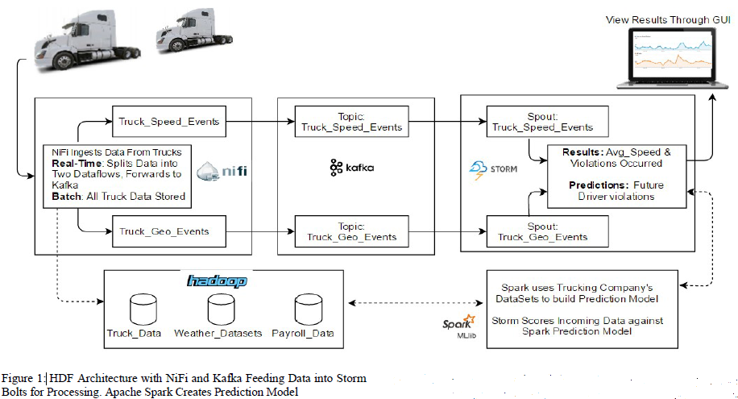
Centralised Data Processing
Fig1: Input embeddings for BERT

Slide 6
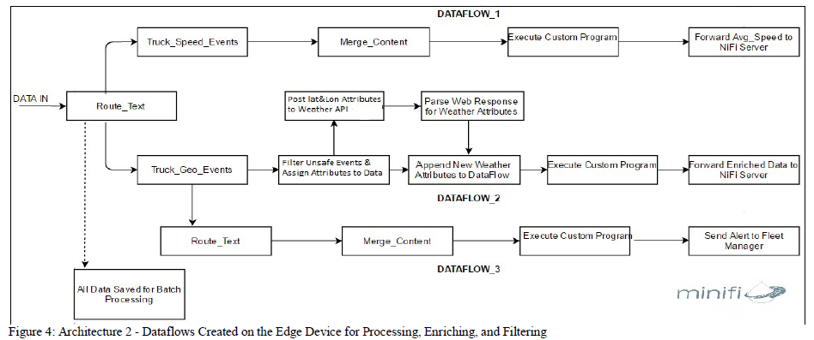
Edge Data Processing

Slide 7
Potential Challenges
1. Computation and resource constraints.
2. Data backup.
3. Remote and resource management.
4. Linguistic Privacy, cyber and physical security.
5. Trust and authentication concerns.
6. Reliability and fault tolerance.
7. Scheduling and load balancing.

Slide 8
Conclusion
Reduces the need of centralized data processing.
Reduces data transmission cost by up to 98%
Ensure the utilization of machine-learning mechanisms

Slide 9
Bibliography
Y. Nakamura, H. Suwa, Y. Arakawa, H. Yamaguchi and K. Yasumoto, "Middleware for Proximity Distributed Real-Time Processing of IoT Data Flows," 2016 IEEE 36th International Conference on Distributed Computing Systems (ICDCS), Nara, 2016, pp. 771-772.
C. Barbieru and F. Pop, "Soft Real-Time Hadoop Scheduler for Big Data Processing in Smart Cities," 2016 IEEE 30th International Conference on Advanced Information Networking and Applications (AINA), Crans-Montana, 2016, pp. 863-870.
A. Papageorgiou, B. Cheng and E. Kovacs, "Real-time data reduction at the network edge of Internet-of-Things systems," 2015 11th International Conference on Network and Service Management (CNSM), Barcelona, 2015, pp. 284-291.
I. Taleb, R. Dssouli and M. A. Serhani, "Big Data Pre-processing: A Quality Framework," 2015 IEEE International Congress on Big Data, New York, NY, 2015, pp. 191-198.
"eclipse.org/krikkit/," Eclipse, [Online]. Available: https://eclipse.org/krikkit/. [Accessed 03 February 2017].
G. Vetticaden, "github.com/georgevetticaden/hdp," 10 December 2016. [Online]. Available:
https://github.com/georgevetticaden/hdp/tree/master/referenceapps/iot-trucking-app.

Slide 10
THANK YOU

